Slide 1


Infrastructure as Code (IaC) on AWS
Notes:
In this module, you will learn about migration and innovation on AWS. This includes migration services, cloud migration strategies, and the AWS Cloud Adoption Framework.

Slide 2



Course: Mastering Amazon AWS
Lecture on: Infrastructure as Code(IaC) on AWS
Instructor: Siddharth Sharma

Slide 3
AWS Trusted Advisor
Notes:
Next, you will examine how to use data and insights about your AWS resources to identify potential areas of improvement.
A service that provides recommendations for improving your AWS environment is AWS Trusted Advisor. The next section uses a coffee shop example to introduce you to Trusted Advisor.

Slide 4
Coffee Shop Improvements
The consultant observes the coffee shop
The consultant offers suggestions for enhancements
.
The owners implement the recommended adjustments
.
Notes:
Now that the coffee shop has been in business for a while, the owners want to improve their operations. They enlist the help of a coffee shop consultant.
The consultant observes the coffee shop’s current business practices, such as order-taking processes, use of supplies, methods for securing digital records, and so on. The consultant compares their observations to established best practices for running a coffee shop.
As the consultant completes their observations, they provide the owners with a summary of their findings and their recommended areas of improvement. This allows the owners to more easily begin making specific changes throughout the shop. Later, the owners can invite the consultant to come back to conduct additional observations and determine which other improvements might benefit the coffee shop.
To receive real-time guidance for how to make improvements throughout your AWS environment, you can use AWS Trusted Advisor.

Slide 5



AWS Trusted Advisor
Get immediate advice on enhancing your AWS environment
Examine your infrastructure in five categories against AWS best practices
At every level of deployment, assess and implement the suggestions
Notes:
AWS Trusted Advisor is a web service that inspects your AWS environment and provides real-time recommendations in accordance with AWS best practices.
Trusted Advisor compares its findings to AWS best practices in five categories: cost optimization, performance, security, fault tolerance, and service limits. For the checks in each category, Trusted Advisor offers a list of recommended actions and additional resources to learn more about AWS best practices.
The guidance provided by AWS Trusted Advisor can benefit your company at all stages of deployment. For example, you can use AWS Trusted Advisor to assist you while you are creating new workflows and developing new applications. Or, you can use it while you are making ongoing improvements to existing applications and resources.

Slide 6


AWS Trusted Advisor Dashboard
Number of products for which no issues have been found
Number of recommended investigations
Number of recommended actions
Notes:
When you access the Trusted Advisor dashboard in the AWS Management Console, you can review completed checks for cost optimization, performance, security, fault tolerance, and service limits, as shown in this example.
For each category:
The green check indicates the number of items for which it detected no problems.
The orange triangle represents the number of recommended investigations.
The red circle represents the number of recommended actions.
Here are a few examples of what these alerts might indicate for Trusted Advisor’s checks in Amazon S3:
A yellow investigation alert might occur if a bucket’s access control list allows any authenticated AWS user to view the objects in the bucket.
A red action alert might occur if a bucket’s access control list allows any authenticated AWS user to upload files to the bucket or delete existing objects.
Although both of these alerts should be remediated, the red alert indicates a greater sense of urgency for action that needs to be taken.

Slide 7
AWS Cloud Adoption Framework
Notes:
In this section, you will explore the AWS Cloud Adoption Framework, which provides guidance to support organizational change throughout the cloud adoption process.

Slide 8
AWS Cloud Adoption Framework
Organises guidance into six areas of focus, which are called perspectives
Provides business guidance to facilitate a speedy and seamless transition to AWS
Notes:
Migrating to the cloud is a process. You don't snap your fingers and have everything magically hosted in AWS. Migrating applications takes effort, and a successful cloud migration requires expertise.
Fortunately, many people have successfully migrated to AWS, and a lot of knowledge about the process has been captured and shared.
That being said, the position you hold in your organization will impact what you need to know and how you can help with a migration. If you are a developer, your role and viewpoint will be much different than a cloud architect, business analyst, or financial analyst. Different types of people bring different perspectives to the table for a migration. You want to harness those different perspectives and make sure that everyone has the same focus.
You also want to ensure that you have the right talent to help support your migration. HR will need to hire at the correct rate to enable your migration. This can be a lot to track, and someone new to the cloud might not think of all the different people who need to be involved.
The AWS Professional Services team created the AWS Cloud Adoption Framework (AWS CAF) to help you manage this process. The Cloud Adoption Framework provides advice to your company to enable a smooth migration to AWS.
At the highest level, the AWS CAF organizes guidance into six areas of focus, called perspectives. Each perspective addresses distinct responsibilities. The planning process helps the right people across the organization prepare for the changes ahead.

Slide 9






Perspectives
Business
People
Governance
Business
capabilities
Technical
capabilities
Platform
Security
Operations
Notes:
Each perspective of the AWS CAF addresses distinct responsibilities. The planning process helps the right people across the organization prepare for the changes ahead. In general, the Business, People, and Governance perspectives focus on business capabilities, whereas the Platform, Security, and Operations perspectives focus on technical capabilities. For example, someone who is a business or finance analysts is part of the Business perspective, HR is part of the People perspective, and a cloud architect is part of the Platform perspective.
Each perspective uncovers gaps in your skills and processes, which are then recorded as inputs. The inputs are then used as the basis for creating an AWS Cloud Adoption Framework Action Plan. You can use the action plan to guide your organization's change management as you journey to the cloud. Having an action plan that makes sense for your organization can help keep you on track towards achieving your desired outcomes.

Slide 10
Business Perspective
Business
People
Governance
Goal
Ensures that investments in IT are linked to important business outcomes and that IT is in line with business needs
Common roles
Finance managers
Budget owners
Strategy stakeholders
Business managers
Platform
Security
Operations
Notes:
The Business perspective ensures that IT aligns with business needs and IT investments link to key business results.
Use the Business perspective to create a strong business case for cloud adoption and prioritize cloud adoption initiatives. Ensure that your business strategies and goals align with your IT strategies and goals.
Common roles in the Business perspective include:
Business managers
Finance managers
Budget owners
Strategy stakeholders

Slide 11
People Perspective
Business
People
Governance
Goal
Helps create an effective change management plan for the entire company to ensure Cloud adoption
Common roles
Staffing
People managers
Human resources
Platform
Security
Operations
Notes:
The People perspective supports development of an organization-wide change management strategy for successful cloud adoption.
Use the People perspective to evaluate organizational structures and roles, new skill and process requirements, and identify gaps. This helps prioritize training, staffing, and organizational changes.
Common roles in the People perspective include:
Human resources
Staffing
People managers

Slide 12
Governance Perspective
Business
People
Governance
Goal
Focuses on the abilities and procedures needed to match business strategy with IT strategy
Common roles
Program managers
Enterprise architects
Chief information officers (CIOs)
Portfolio managers
Business analysts
Platform
Security
Operations
Notes:
The Governance perspective focuses on the skills and processes to align IT strategy with business strategy. This ensures that you maximize the business value and minimize risks.
Use the Governance perspective to understand how to update the staff skills and processes necessary to ensure business governance in the cloud. Manage and measure cloud investments to evaluate business outcomes.
Common roles in the Governance perspective include:
Chief information officer (CIO)
Program managers
Enterprise architects
Business analysts
Portfolio managers

Slide 13
Platform Perspective
People
Governance
Goal
Includes guidelines and models for introducing novel cloud-based solutions and moving workloads from on-premises systems to the Cloud
Common roles
IT managers
Solutions architects
Chief technology officers (CTOs)
Platform
Security
Operations
Notes:
The Platform perspective includes principles and patterns for implementing new solutions in the cloud, and migrating on-premises workloads to the cloud.
Use a variety of architectural models to understand and communicate the structure of IT systems and their relationships. Describe the architecture of the target state environment in detail.
Common roles in the Platform perspective include:
Chief technology officer (CTO)
IT managers
Solutions architects

Slide 14
Security Perspective
Business
People
Governance
Goal
Ensures that the company satisfies its security goals in terms of auditability, control, visibility and agility
Common roles
IT security managers
IT security analysts
Chief information security officers (CISOs)
Platform
Security
Operations
Notes:
The Security perspective ensures that an organization meets security objectives for visibility, auditability, control, and agility.
Use the AWS CAF to structure the selection and implementation of security controls that meet the organization’s needs.
Common roles in the Security perspective include:
Chief information security officer (CISO)
IT security managers
IT security analysts

Slide 15
Operations Perspective
Business
People
Governance
Goal
Assists you in enabling, using, recovering from and operating IT workloads to the degree that you and your business stakeholders have decided upon
Common roles
IT support managers
IT operations managers
Platform
Security
Operations
Notes:
The Operations perspective helps you to enable, run, use, operate, and recover IT workloads to the level agreed on with your business stakeholders.
Define how day-to-day, quarter-to-quarter, and year-to-year business is conducted. Align with and support the operations of the business. The AWS CAF helps stakeholders define current operating procedures and identify the process changes and training needed to implement successful cloud adoption.
Common roles in the Operations perspective include:
IT operations managers
IT support managers
Migrating to the cloud can be complicated, but you are not alone in this. You have access to many resources that can help you get started, and the AWS Cloud Adoption Framework is a helpful place to look.

Slide 16
Migration Strategies
Notes:
This section examines six strategies that you can consider implementing when preparing for a cloud migration.

Slide 17




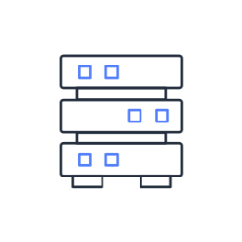





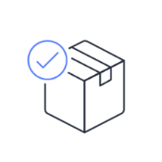

Six Migration Strategies
Rehost
Replatform
Refactor/Rearchitect
Repurchase
Applications to migrate
Discovery phase
Retain
Retire
Notes:
Suppose that you want to migrate from your on-premises deployment to AWS. Ideally, you could snap your fingers and instantly have all the elements from your existing on-premises data center magically appear on AWS, optimized and efficient. However, migrating doesn't work that way.
Every application (or application groups, if they're tightly coupled) has six possible options for a migration. These are known as the six Rs of migration. Once you complete the discovery phase and know exactly what is present in your existing environment, decide which of the six Rs might be the best option, based on factors such as time, cost, priority, and criticality.
When migrating applications to the cloud, six of the most common migration strategies that you can implement are:
Rehosting
Replatforming
Refactoring/re-architecting
Repurchasing
Retaining
Retiring
Rehosting (also known as lift and shift) involves moving applications without changes. In the scenario of a large legacy migration, in which the company is looking to implement its migration and scale quickly to meet a business case, the majority of applications are rehosted.
Replatforming (also known as lift, tinker, and shift) involves making a few cloud optimizations to realize a tangible benefit. Optimization is achieved without changing the core architecture of the application.
Refactoring (also known as rearchitecting) involves reimagining how an application is architected and developed by using cloud-native features. Refactoring is driven by a strong business need to add features, scale, or performance that would otherwise be difficult to achieve in the application’s existing environment.
Repurchasing involves moving from a traditional license to a software as a service model. For example, a business might choose to implement the repurchasing strategy by migrating from a customer relationship management (CRM) system to Salesforce.com.
The final two strategies, retaining and retiring, do not involve moving applications to the cloud.
Retaining consists of keeping applications that are critical for the business in the source environment. This might include applications that require major refactoring before they can be migrated, or, work that can be postponed until a later time.
Retiring is the process of removing applications that are no longer needed.

Slide 18
AWS Snow Family
Notes:
Suppose that you have a large amount of data that you need to transfer into the AWS Cloud. For this type of workload, you can use devices that are part of the AWS Snow Family. The AWS Snow Family is a collection of physical devices that help to physically transport up to exabytes of data into and out of AWS.

Slide 19
AWS Snow Family
AWS Snowcone
AWS Snowball devices
AWS Snowmobile
A compact, sturdy and safe edge computing and data transmission apparatus
Features 8 TB of usable storage
AWS Snowball Edge Storage Optimized
AWS Snowball Edge Compute Optimized
AWS data transfer service on an exabyte scale for transferring massive volumes of data
Transfers up to 100 PB of data
Notes:
The AWS Snow Family is composed of AWS Snowcone, AWS Snowball, and AWS Snowmobile. These devices offer different capacity points, and most include built-in computing capabilities. AWS owns and manages the Snow Family devices and integrates with AWS security, monitoring, storage management, and computing capabilities.
AWS Snowcone is a small, rugged, and secure edge computing and data transfer device. It features 2 CPUs, 4 GB of memory, and 8 TB of usable storage.
AWS offers two types of AWS Snowball devices:
Snowball Edge Storage Optimized devices are well suited for large-scale data migrations and recurring transfer workflows, in addition to local computing with higher capacity needs.
Storage: 80 TB of hard disk drive (HDD) capacity for block volumes and Amazon S3 compatible object storage; 1 TB of SATA solid state drive (SSD) for block volumes
Compute: 40 vCPUs; 80 GiB of memory to support Amazon EC2 sbe1 instances (equivalent to C5)
Snowball Edge Compute Optimized provides powerful computing resources for use cases such as machine learning, full motion video analysis, analytics, and local computing stacks.
Storage: 42-TB usable HDD capacity for Amazon S3 compatible object storage or Amazon EBS compatible block volumes; 7.68 TB of usable NVMe SSD capacity for Amazon EBS compatible block volumes
Compute: 52 vCPUs; 208 GiB of memory; optional NVIDIA Tesla V100 GPU; run Amazon EC2 sbe-c and sbe-g instances, which are equivalent to C5, M5a, G3, and P3 instances
AWS Snowmobile is an exabyte-scale data transfer service used to move large amounts of data to AWS. You can transfer up to 100 petabytes of data per Snowmobile, which is a 45-foot long ruggedized shipping container, pulled by a semitrailer truck.

Slide 20
Innovation With AWS
Notes:
The next section of this module examines innovation with AWS.

Slide 21
Innovation With AWS
Clarifying the following requirements is essential for fostering innovation in the Cloud:
Desired state
Problems you are trying to solve
Current state
Notes:
When examining how to use AWS services, focus on the desired outcomes. You are properly equipped to drive innovation in the cloud if you can clearly articulate the following:
Current state
Desired state
Problems you are trying to solve
Consider some of the paths you might explore in the future as you continue on your cloud journey.

Slide 22


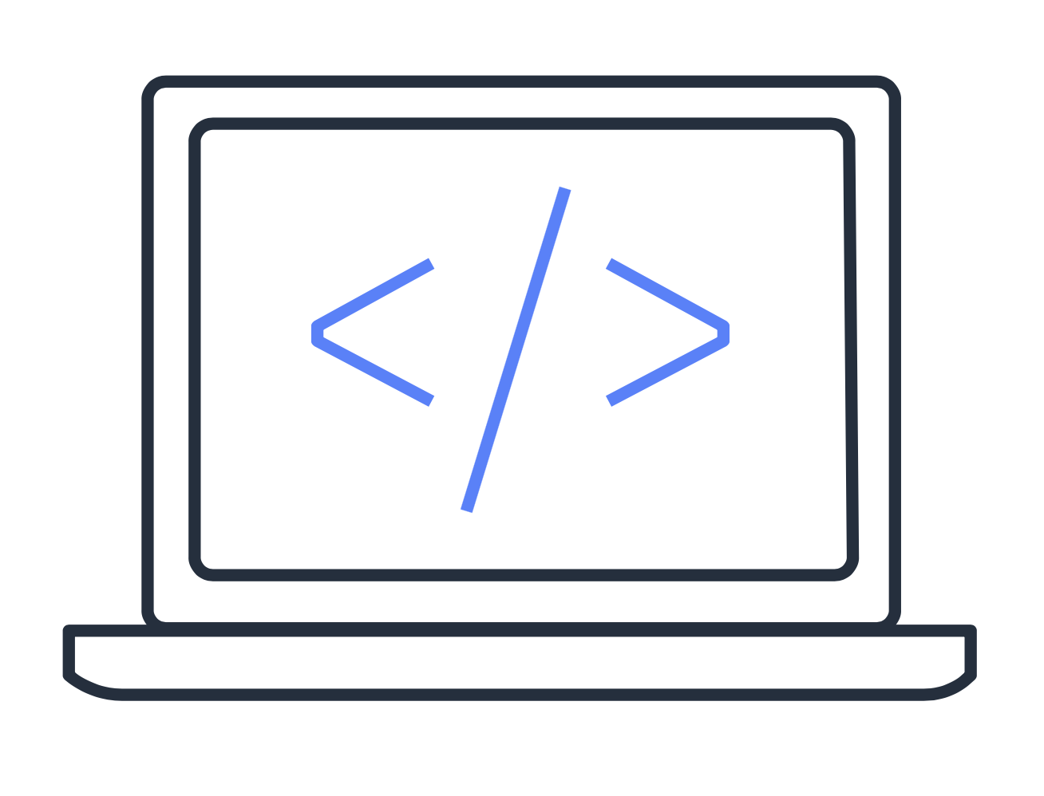
Innovation Paths
As you proceed on your cloud journey, consider some of these innovation pathways
Serverless applications
Artificial intelligence (AI)
Machine learning (ML)
Notes:
Serverless applications: With AWS, serverless refers to applications that don’t require you to provision, maintain, or administer servers. AWS handles fault tolerance and availability for you.
AWS Lambda is an example of a service that you can use to run serverless applications. If you design your architecture to trigger Lambda functions to run your code, you can bypass the need to manage a fleet of servers. Building your architecture with serverless applications helps developers focus on their core product instead of managing and operating servers.
Artificial intelligence (AI): AWS offers a variety of services powered by AI. For example, you can:
Convert speech to text with Amazon Transcribe
Discover patterns in text with Amazon Comprehend
Identify potentially fraudulent online activities with Amazon Fraud Detector
Build voice and text chatbots with Amazon Lex
Machine learning (ML): Traditional machine learning development is complex, expensive, time consuming, and error prone. AWS offers Amazon SageMaker to remove the difficult work from the process and empower you to build, train, and deploy ML models quickly. You can use ML to analyze data, solve complex problems, and predict outcomes.

Slide 23
AWS Well-Architected Framework
Notes:
Throughout this course, you have learned about a wide range of AWS services. You can use these services as building blocks for your cloud architecture. To help you evaluate how well your architecture aligns with best practices, you can use the Well-Architected Framework.

Slide 24
Well-Architected Framework
With the aid of the Well-Architected Framework, you can create and manage dependable, safe, economical and efficient systems in AWS Cloud
It is based on these five pillars:
  Reliability
  Security
  Cost optimisation
  Performance efficiency
  Operational excellence
Notes:
The Well-Architected Framework helps you understand how to design and operate reliable, secure, efficient, and cost-effective systems in the AWS Cloud. It provides a way for you to consistently measure your architecture against best practices and design principles and identify areas for improvement.
The Well-Architected Framework is based on five pillars:
Operational excellence
Security
Reliability
Performance efficiency
Cost optimization

Slide 25
Operational Excellence
Manage and track systems to provide value to the business and continuously enhance related processes and procedures
Annotate documentation
Perform operations as code
Refine operations procedures frequently
Anticipate failure
Make frequent, small and reversible changes
Notes:
The first pillar is operational excellence. It focuses on running and monitoring systems to deliver business value, and with that, continually improving processes and procedures. For example, automating changes with deployment pipelines, or responding to events that are triggered.
Design principles for operational excellence in the cloud include performing operations as code, annotating documentation, anticipating failure, and frequently making small, reversible changes.

Slide 26
Security
Delivering company value while safeguarding data, systems, and assets via risk assessments and mitigation techniques
Automate security best practices
Apply security at all layers
Protect data in transit and at rest
Notes:
The security pillar is the ability to protect information, systems, and assets while delivering business value through risk assessments and mitigation strategies.
When considering the security of your architecture, apply these best practices:
Automate security best practices when possible
Apply security at all layers
Protect data in transit and at rest

Slide 27
Reliability
Testing recovery procedures, expanding horizontally to boost overall system availability and automatically recovering from errors
Mitigate disruptions such as misconfigurations or transient network issues
Dynamically acquire computing resources to meet demand
Recover from infrastructure or service disruptions
Notes:
Reliability is the ability of a system to do the following:
Recover from infrastructure or service disruptions
Dynamically acquire computing resources to meet demand
Mitigate disruptions such as misconfigurations or transient network issues
Reliability includes testing recovery procedures, scaling horizontally to increase aggregate system availability, and automatically recovering from failure.

Slide 28
Performance Efficiency
Utilise computer resources effectively to fulfil system needs, and continue this even as demands change and technologies evolves?
Go global in minutes
Use serverless architectures
Experiment frequently
Notes:
Performance efficiency is the ability to use computing resources efficiently to meet system requirements, and maintain that efficiency as demand changes and technologies evolve. An example of performance efficiency is choosing the right Amazon EC2 instance type for an application.
Evaluating the performance efficiency of your architecture includes experimenting more often, using serverless architectures, and designing systems to be able to go global in minutes.

Slide 29
Cost Optimisation
Run systems to deliver business value at the lowest price point
Use managed services to reduce the cost of ownership
Analyse and attribute expenditure
Adopt a consumption model
Notes:
Cost optimization is the ability to run systems to deliver business value at the lowest price point. For example, suppose that you are analyzing your Amazon EC2 compute usage. If you have overestimated your compute needs, you could lower your costs by choosing a more cost-effective instance type.
Cost optimization includes adopting a consumption model, analyzing and attributing expenditure, and using managed services to reduce the cost of ownership.

Slide 30
Deploying With Amazon MQ

Slide 31

Amazon MQ
A managed message broker service for Apache MQ
Is compatible with open standard APIs and protocols
  Including JMS, NMS, AMQP, STOMP, MQTT and WebSocket
Provides direct access to the ActiveMQ console
Makes it easy to set up and operate message brokers in the Cloud
Notes:
Amazon MQ is a managed message broker service for Apache ActiveMQ that makes it easy to set up and operate message brokers in the cloud. Message brokers allow different software systems–often using different programming languages, and on different platforms–to communicate and exchange information. Messaging is the communications backbone that connects and integrates the components of distributed applications, such as order processing, inventory management, and order fulfillment for ecommerce. Amazon MQ manages the administration and maintenance of ActiveMQ, a popular open-source message broker. The underlying infrastructure is automatically provisioned for high availability and message durability to support the reliability of your applications. With Amazon MQ, you get direct access to the ActiveMQ console and industry standard APIs and protocols for messaging, including JMS, NMS, AMQP, STOMP, MQTT, and WebSocket. You can easily move from any message broker that uses these standards to Amazon MQ because you don’t have to rewrite any messaging code in your applications.

Slide 32


High Availability and Durability
Active broker
Standby broker
Availability Zone
Availability Zone
Replicated Message Store
Replicated Message Store
Notes:
An active/standby broker for high availability is comprised of two brokers in two different Availability Zones, configured in a redundant pair. These brokers communicate synchronously with your application, and with a shared storage location.
Normally, only one of the broker instances is active at any time, while the other broker instance is on standby. If one of the broker instances malfunctions or undergoes maintenance, it takes Amazon MQ a short while to take the inactive instance out of service, allowing the healthy standby instance to become active and to begin accepting incoming communications.
Amazon MQ brokers can be created as single-instance brokers or active/standby brokers for high availability. For both deployment modes, Amazon MQ provides high durability by storing its data redundantly, across multiple Availability Zones (multi-AZs) within an AWS Region. Amazon MQ ensures high availability by providing failover to a standby instance in a second Availability Zone.

Slide 33
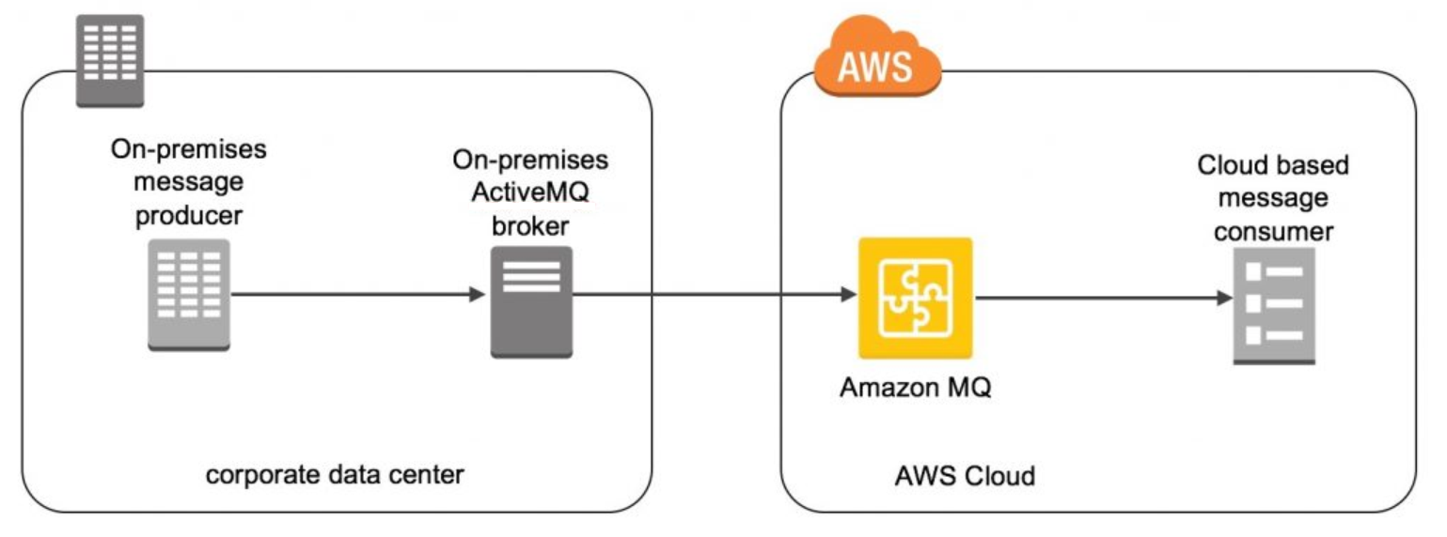
Use Case: Hybrid Integration
Notes:
Organizations have started to build new or “lift and shift” applications to AWS. In some cases, there are applications, such as mainframe systems, too costly to migrate. In these scenarios, those on-premises applications still need to interact with cloud-based components. Amazon MQ is a managed message broker service for ActiveMQ that enables organizations to send messages between applications in the cloud and on-premises to enable hybrid environments and application modernization. ActiveMQ is an open-source message broker written in Java that is packaged with clients in multiple languages, Java Message Server (JMS) client being one example.
This diagram shows you can use Amazon MQ to integrate on-premises and cloud environments using the network of brokers feature of ActiveMQ. It outlines the message lifecycle from the on-premises producer to the on-premises broker, traversing the hybrid connection between the on-premises broker and Amazon MQ, and finally consumption within the AWS Cloud.
For more information, see https://aws.amazon.com/blogs/compute/running-activemq-in-a-hybrid-cloud-environment-with-amazon-mq/.

Slide 34
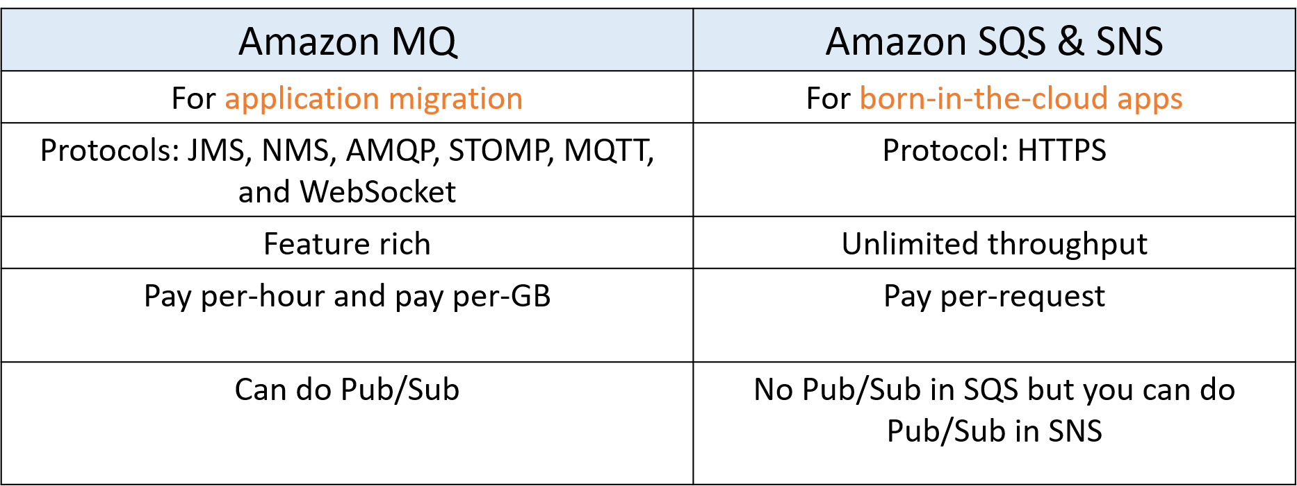
When to Use MQ vs SQS or SNS
Notes:
Amazon MQ, Amazon SQS, and Amazon SNS are messaging services that are suitable for anyone from startups to enterprises. If you're using messaging with existing applications, and want to move your messaging to the cloud quickly and easily, we recommend you consider Amazon MQ. It supports open standard APIs and protocols so you can switch from any standards-based message broker to Amazon MQ without rewriting the messaging code in your applications. If you are building brand new applications in the cloud, we recommend you consider Amazon SQS and Amazon SNS. Amazon SQS and SNS are lightweight, fully managed message queue and topic services that scale almost infinitely and provide simple, easy-to-use APIs. You can use Amazon SQS and SNS to decouple and scale microservices, distributed systems, and serverless applications, and improve reliability.

Slide 35
Thank You!

